Slide 1
NOJ season 2
Fang Wang

Slide 2
season 2
question 1 GCD
question 2 Reducing Fractions to Lowest Terms
question 3 Even squares
question 4 Commission
question 5 Lucky number
question 6 Yellow Cabs
question 7 leap year
question 8 Date Calculator
question 9 GRADE
question 10 TIME

Slide 3
How to write a program?
Get rooms
Step 1: declare variables
Step 2: input data
Step 3: calculate
Step 4: output
Store data
calculate
print the result

Slide 4
Selection Statements
A conditional flow statement is a mechanism that allows you to branch your program flow in one or more directions based on the result of a certain test
if(a>b)
{ printf(“a is greater”); }
else
{printf(“b is greater”); }

Slide 5
Conditional Expressions
  The conditional operator consists of two symbols (? and :), which must be used together:
expr1 ? expr2 : expr3
a>b?a:b
C’s conditional operator allows an expression to produce one of two values depending on the value of a condition.
  max=(a>b)?a:b;
  if (a>b) max=a;
  else max=b;

Slide 6
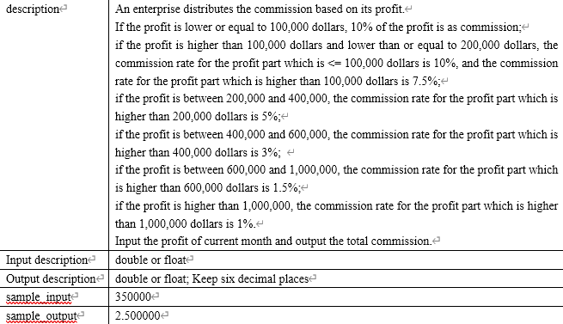
question 4 Commission
Output monetary unit:10000dollars
e.g. 2.500000 means 25000 dollars

Slide 7
Step 1: declare variables
Step 2: input data
Step 3: calculate
Step 4: output
if(i<=100000) m=i*0.1;
else if(i<200000) m=100000*0.1+(i-100000)*0.075;
else if(i<400000) m=……
else if(i<600000) m=……
else if(i<1000000) m= ……
else m=…….
printf("%f",m/10000);
Output monetary unit:10000dollars
e.g. 2.500000 means 25000 dollars

Slide 8
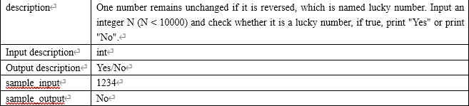
question 5 Lucky number

Slide 9
1234------4 3 2 1--------4321
1234%10 --------4
1234/10------123 （NOT123.4） 123%10-------3 4*10+3
123/10------12 （NOT12.3） 12%10-------2 43*10+2
12/10------1 （NOT1.2） 1%10-------1 432*10+1
j/10 | quotient | j%10 | remainder | Sum*10 +(j%10) | sum
 |  | 1234%10 | 4 | 4 | 4
1234/10 | 123 （NOT123.4） | 123%10 | 3 | 4*10+3 | 43
123/10 | 12 （NOT12.3） | 12%10 | 2 | 43*10+2 | 432
12/10 | 1（NOT1.2） | 1%10 | 1 | 432*10+1 | 4321

Slide 10
Step 1: declare variables
Step 2: input data
Step 3: calculate
Step 4: output
sum = 0;
j = num;
while(j>0)
{
sum = 10*sum + (j%10);
j=j/10;
}
if (sum == num) printf("Yes\n");
else printf("No\n");

Slide 11
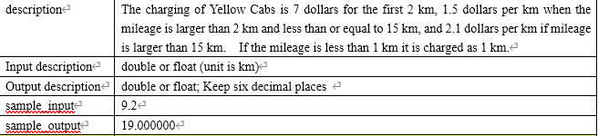
question 6 Yellow Cabs

Slide 12
scanf("%lf",&x);
tmp=(int)x; //9.2km-----9km
if(fabs(tmp-x)) tmp++; //9km------10km
if(tmp<=2)money=7;
else if(tmp<=15)money=7+(tmp-2)*1.5;
else if(tmp>15)money=7+13*1.5+(tmp-15)*2.1;

Slide 13
Type Conversion Operator
Casting
  we sometimes need a greater degree of control over type conversion. For this reason, C provides casts.
  A cast expression has the form
( type-name ) expression
type-name specifies the type to which the expression should be converted.
(int)2.756-----------2 dont round it

Slide 14
Type Conversion
Casting
  Using a cast expression to compute the integer part of a float/double value:
double f=3.5, int_part;
int_part = (int) f;
  (int) f is the integer part of f
  f: 3.5
  (int) f: 3

Slide 15
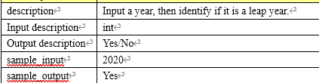
question 7 leap year

Slide 16
Any year that is evenly divisible by 4 but not evenly divisible by100 is a leap year
y%4==0&&y%100!=0
Or
Any year that is evenly divisible by 400 is a leap year
y%400==0

Slide 17
int y;
scanf("%d",&y);
if(y%400==0||(y%4==0&&y%100!=0))
printf("Yes\n");
else printf("No\n");

Slide 18
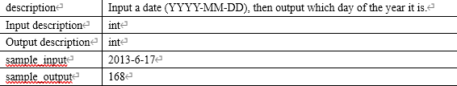
question 8 Date Calculator

Slide 19
switch(mo)
{
case 12:day+=30; //add days of Nov.
case 11:day+=31; // add Oct.
case 10:day+=30; // add Sep.
case 9:day+=31; // add Aug.
case 8:day+=31;
case 7:day+=30;
case 6:day+=31;
case 5:day+=30;
case 4:day+=31;
case 3:day+=28;
case 2:day+=31;
}
int day=0,mo,ye;
scanf("%d-%d-%d",&ye,&mo,&day);
if((ye%400==0||(ye%4==0&&ye%100!=0)))
if(mo>2) day++;
printf("%d",day);

Slide 20
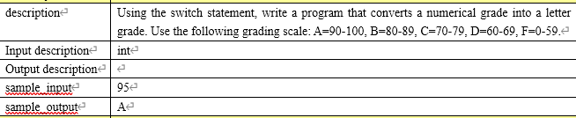
question 9 GRADE

Slide 21
int a;
scanf("%d",&a);
switch(a/10)
{
case 10:
case 9: printf("A\n");break;
case 8: printf("B\n");break;
case 7: printf("C\n");break;
case 6: printf("D\n");break;
default: printf("E\n");break;
}
int/int----int(don’t round it)
90/10----9
91/10----9
99/10----9

Slide 22
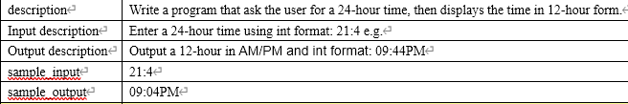
question 10 TIME

Slide 23
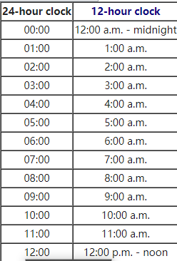
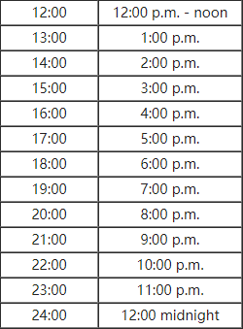

Slide 24
int hours, minutes;
scanf("%d:%d", &hours, &minutes);
if (hours == 0)
printf("12:%02dAM\n", minutes); //0:4-------- 12:04AM
else if (hours < 12)
printf("%02d:%02dAM\n", hours, minutes); //1:4-------- 01:04AM
else if (hours == 12)
printf("%02d:%02dPM\n", hours, minutes); //12:4-------- 01:04PM
else
printf("%02d:%02dPM\n", hours - 12, minutes);
//13:4-------- 01:04PM

Slide 25
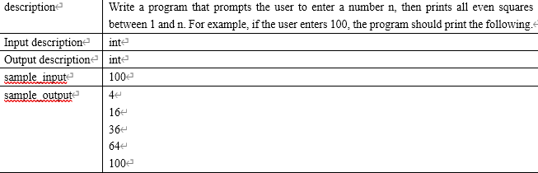
question 3 Even squares

Slide 26
Step 1: declare variables
int i, n;
scanf("%d", &n);
for (i = 2; i * i <= n; i += 2)
printf("%d\n", i * i);
Step 2: input data
Step 3: calculate
Step 4: output

Slide 27
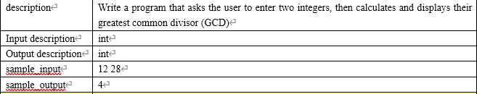
GCD

Slide 28
Step 1: declare variables
int m, n, i;
scanf("%d%d", &m, &n);
i=m>n?n:m;
for (;i>0;i--)
if(m%i==0&&n%i==0) break;
printf("%d\n", i);
Step 2: input data
Step 3: calculate
Step 4: output

Slide 29
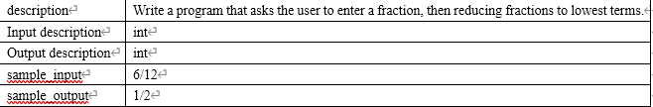
Reducing Fractions to Lowest Terms

Slide 30
int m, n, i; //denominator/Molecular
scanf("%d/%d", &m, &n);
i=m>n?n:m;
for (;i>0;i--)
if(m%i==0&&n%i==0) break;
printf("%d/%d\n", m/i,n/i);
Step 1: declare variables
Step 2: input data
Step 3: calculate
Step 4: output

